Slide 1

BUSINESS REGISTRATION FORM
Contents:-
1.Html
2.Css
3.javaScript
4.Testplan Documentation
5.SRS Documentation
6.Test Cases
7.Test Scenario
8.Eclipse
9.Selenium

Slide 2
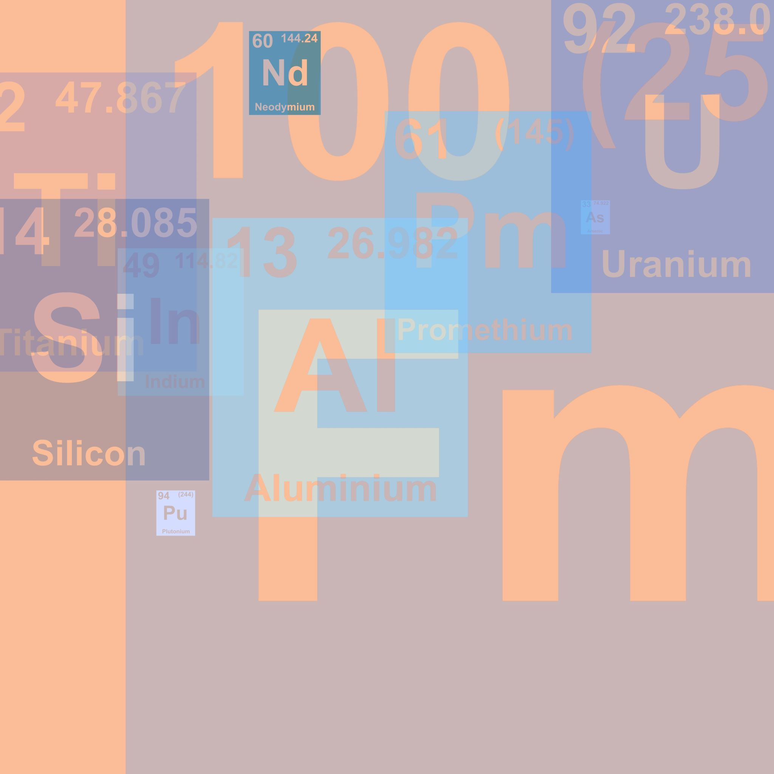
Selenium
Selenium is a free (open-source) automated testing framework used to validate web applications across different browsers and platforms. You can use multiple programming languages like Java, C#, Python etc to create Selenium Test Scripts. Testing done using the Selenium testing tool is usually referred to as Selenium Testing.
Selenium Software is not just a single tool but a suite of software, each piece catering to different Selenium QA testing needs of an organization. Here is the list of tools
Selenium Integrated Development Environment (IDE)
Selenium Remote Control (RC)
WebDriver

Slide 3
Thank u all
end

Slide 4
Html
The HyperText Markup Language or HTML is the standard markup language for documents designed to be displayed in a web browser. It can be assisted by technologies such as Cascading Style Sheets (CSS) and scripting languages such as JavaScript.
HTML (HyperText Markup Language) is the code that is used to structure a web page and its content. For example, content could be structured within a set of paragraphs, a list of bulleted points, or using images and data tables

Slide 5
CSS
Cascading Style Sheets (CSS) is a style sheet language used for describing the presentation of a document written in a markup language such as HTML or XML (including XML dialects such as SVG, MathML or XHTML). CSS is a cornerstone technology of the World Wide Web, alongside HTML and JavaScript.

Slide 6
JAVASCRIPT
JavaScript (often shortened to JS) is a lightweight, interpreted, object-oriented language with first-class functions, and is best known as the scripting language for Web pages, but it's used in many non-browser environments as well.
JavaScript is the world's most popular programming language. JavaScript is the programming language of the Web

Slide 7

TEST PLAN DOCUMENTATION
A Test Plan refers to a detailed document that catalogs the test strategy, objectives, schedule, estimations, deadlines, and the resources required for completing that particular project. Think of it as a blueprint for running the tests needed to ensure the software is working properly – controlled by test managers
A test plan is the foundation of every testing effort. It helps set out how the software will be checked, what specifically will be tested, and who will be performing the test. By creating a clear test plan all team members can follow, everyone can work together effectively.

Slide 8

SRS DOCUMENTATION
A software requirements specification (SRS) is a document that describes what the software will do and how it will be expected to perform. It also describes the functionality the product needs to fulfill all stakeholders (business, users) needs.
We want to DEFINE the purpose of our product, DESCRIBE what we are building, DETAIL the individual requirements, and DELIVER it for approval. A good SRS document will define everything from how software will interact when embedded in hardware to the expectations when connected to other software. An even better SRS documents also account for real-life users and human interaction.

Slide 9

Test Cases
Test management tool
Bug tracking tool
Automated testing tool
Performance testing tool
Cross-browser testing tool
Integration testing tool
Unit testing tool
Mobile/android testing tool
GUI testing tool
Security testing tool

Slide 10

Test scenario
In liner statements, a test scenario is a complete list containing test cases that cover end-to-end functionality of a software program. A scenario is defined as a liner statement. The test scenario is a classification of testable requirements at a high level.
First I Write the Test Scenarios then I go through Test Cases

Slide 11

Inside ECLIPSE
When Opening the Eclipse then I give the Microsoft Edge link
Then I use driver.get(url) function
Then I use Send keys method to send text
Also I give click Functionality to operate that Function
In this it navigate to local path and thent it run

